Slide 1
Leaders and Organizational Change
Dr. Sweta S. Malla
Indian Institute of Foreign Trade-New Delhi

Slide 2
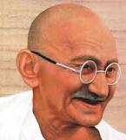
Who is this?

Slide 3
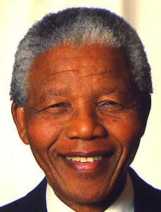
Who is this?

Slide 4
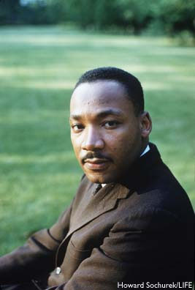
Who is this?

Slide 5
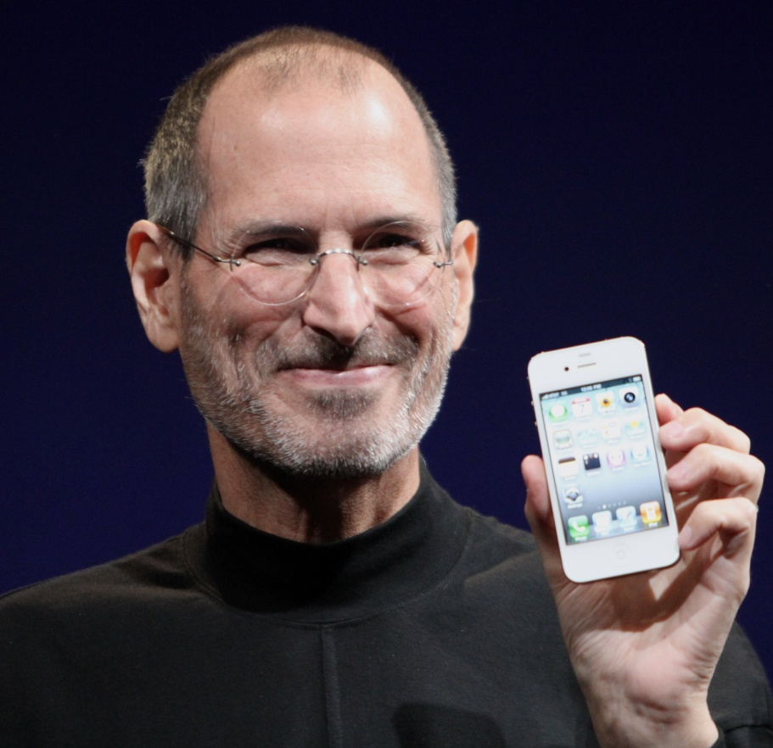
Who is this?

Slide 6
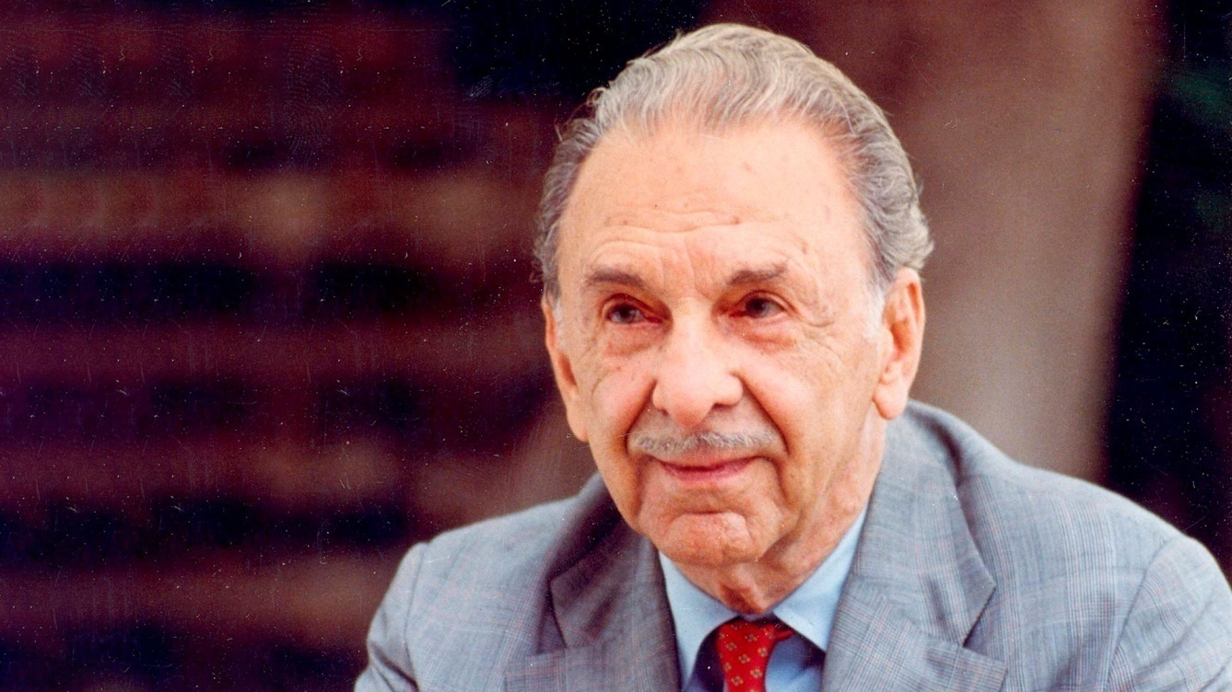
Who is this?

Slide 7
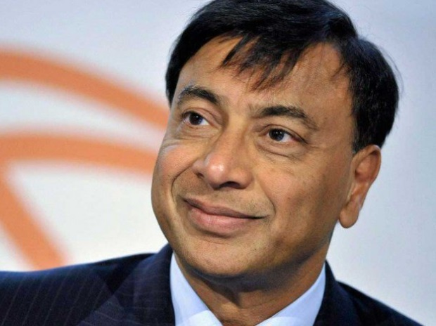
Who is this?

Slide 8
What is leadership?
Leading people
Influencing people
Commanding People
Guiding People

Slide 9
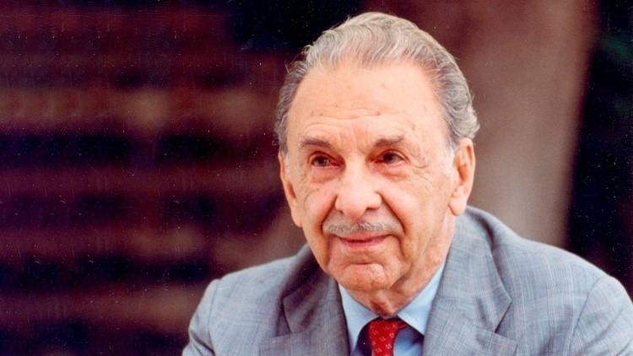

Change agents Leading the People

Slide 10
HOW MUCH DO YOU KNOW ABOUT THE CHANGE PROCESS
True or False.
1.Because change is so much of everyday life, most modern workers like new work procedures and policies.
2.Many employees like the status quo, change scares them.
3. If a computer designed to help them do their work were available, most employees would try to learn how to use the machine as quickly as possible.
4. Most organizational changes that are introduced are truly designed to increase efficiency.
5. If their friends at work are opposed to change, most workers will also oppose change.
6. Most people who resist change do so because they enjoy giving their organization a hard time.
7. Unions tend to reject new work changes.

Slide 11
What is Organizational Change?
An alteration of an organization’s environment, structure, culture, technology, or people.

Slide 12
What causes change?
Globalization
Mergers & Acquisitions
Competition
Deregulation
Price & Cost Pressures
Quality Improvement Efforts
Continuous Improvement
Response to New Technology
New Products & Services
Change in Management

Slide 13
Why is Change Denied and Resisted?
Resistance increases when...
1. The purpose of the change is not made clear.
2. The need for change is not understood.
3. Communication regarding the change is poor.
4. People who will be involved with the change are not included in planning.
5. There are no rewards.
6. Key people are not seen as really supporting the change.
7. People perceive a negative impact on their social relations.
8. Change is introduced too slowly or quickly.
9. Habit patterns are ignored.
12. There is a tendency to seek security in the past.
13. There is a lack of confidence in the outcome of change.
14. Too much pressure exists.
……………………….

Slide 14
Why is Change Denied and Resisted? (cont.)
15. Vested interests are involved.
16. The status quo can’t be reestablished if the change proves unacceptable.
17. People believe the change will reflect negatively on their past performances.
18. Poor behavior on the part of others is tolerated during the change process.
19. The change process is not open to input or critique.
20. Decisions are passed down hierarchically and therefore some people have much information and others have little.
21.The timing for the change is bad.
22. One change means many changes.
23. People want to know what the outcome will be before the change occurs.
24. Behavioral change usually comes in small steps.
Pritchett and Pound

Slide 15
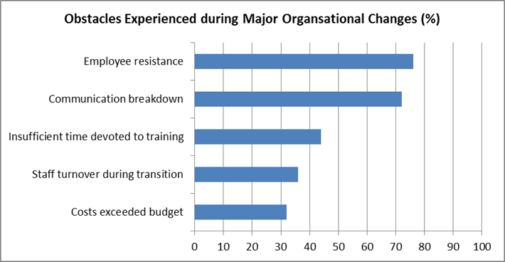

Slide 16
Change Vision =3 Cs
Communicate
Collaborate
Commit

Slide 17
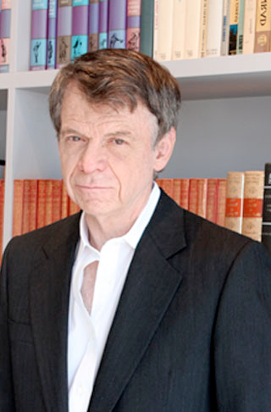
Eight Stage Change Process
Note: the sequence is important!
Establish a sense of urgency
Create a guiding coalition
Develop a vision and strategy
Communicate your change vision
Empower broad-based action
Generate short term wins
Consolidate gains and produce more change
Anchor new approaches in the culture
John Kotter, 1996

Slide 18
“The soul never thinks without a picture.” -Aristotle
The vision “magnetically” pulls the organization
Imaginable
Desirable
Feasible
Focused
Flexible
Communicable

Slide 19
Version 1: Our goal is to reduce our mean time to repair parameters so that they are perceptually lower than all major competitors inside the country and out. In a similar vein, we have targeted new product development cycle times, order process times, and other customer-relevant processes for change.
Version 2: We are going to become faster than anyone in our industry at satisfying customer needs.

Slide 20
Nothing motivates more than success. Give your company a taste of victory early in the change process. Within a short time frame (this could be a month or a year, depending on the type of change), you'll want to have results that your staff can see. Without this, critics and negative thinkers might hurt your progress.

Slide 21
Generating sufficient wins fast enough to diffuse cynicism, pessimism and skepticism. Building momentum. Making sure successes are visible, unambiguous, and speak to what people deeply care about.

Slide 22
Thank You

